Slide 1

>>>>> Before You Begin <<<<<
Less is more
Avoid paragraphs and long sentences
Use the 5x5 rule — max of 5 lines, 5 words each
One idea per slide
Notes:
Esri Corporate Template-Dark v4.0
September 29, 2021

Slide 2

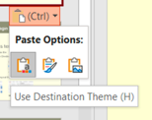
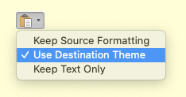
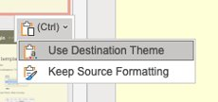

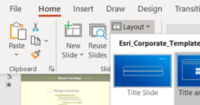
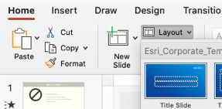
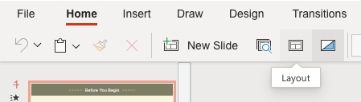
>>>>> Before You Begin <<<<<
How to apply this template
Copy existing slides into this file
When pasting, choose Use Destination Theme
Adjust your slides: titles are now larger and lower on the slide for better visibility
For consistent title placement, you may need to select a layout from the Layout menu
For a brief video tutorial, click here
Windows
Mac
Web
Windows
Mac
Web

Slide 3

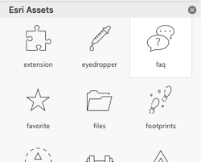
>>>>> Before You Begin <<<<<
Design resources
Icons
Load Esri-created icons straight into your deck!
From the Home ribbon above, click Esri Icons
Presentation Resources [link]
Diagrams, Tables and Timelines [link]
Esri Design Template
Windows [link] | Mac [link]
Backgrounds [link]
Strategic Presentations [link]
Stock photos
Adobe Stock images are available. See the details.

Slide 4


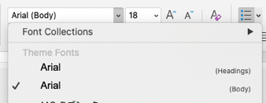
>>>>> Before You Begin <<<<<
Arial or
Use Arial font everywhere
Pick Arial [Headings] or [Body] from the top of the font list
See FAQ “Theme Fonts” for details [link]
Avenir Next is no longer supported
See FAQ “Arial or Avenir Next” for details [link]

Slide 5


What’s New in v2.0 of ArcGIS API for Python
Nanae Aubry
John Yaist
2022 ESRI DEVELOPER SUMMIT
Notes:
2022 Esri Developer Summit

Slide 6

Agenda
ArcGIS API for Python 2.0 – Released January 2022
Changes across the API
some breaking
Individual Module Highlights

Slide 7


Breaking Changes?...
WHY?

Slide 8

It’s simple…

Slide 9

We’re
Sadists!

Slide 10

Ooooopssss…. I mean
Performance Improvements
Technology Alignment

Slide 11
Primary Breaking Change: Spatially Enabled Dataframe
Deprecate SpatialDataFrame class
Used to access with df property on a FeatureSet
Now there is sdf property on Feature set to return Pandas df with a spatial property
Replaced with Pandas extension pattern
Improved validation in conversion methods: to_featurelayer(), to_featureclass()
Default - doesn’t mutate the source data unless you want…validation is under your control

Slide 12

Lazy Loading
Modules are not loaded until needed

Slide 13
New Modules
arcgis.auth
arcgis.gis.agoserver
arcgis.apps.storymap

Slide 14
New Guides and Samples
Presenter Names
2022 ESRI DEVELOPER SUMMIT
Notes:
2022 Esri Developer Summit

Slide 15
New Classes ?
John
2022 ESRI DEVELOPER SUMMIT
Notes:
2022 Esri Developer Summit

Slide 16

arcgis.auth
Accessible by users….designed for developers!
Contains:
Session object
Authentication Handlers

Slide 17

Mapping Authentication to Authentication Classes
Anonymous - Nothing
Token Authentication
ArcGIS Pro – ArcGISProAuth
Username/Password – EsriBuiltInAuth and EsriGenTokenAuth
Notebook Server - EsriNotebookAuth
User Provided Token - EsriUserTokenAuth
API Token - EsriAPIKeyAuth
OAuth 2.0 - EsriOAuth2Auth
Wed-tier Authentication and Identity Store
PKI - EsriPKIAuth
Basic - EsriBasicAuth
Digest - EsriDigestAuth
IWA/Kerberos – EsriWindowsAuth/EsriKerberosAuth

Slide 18
Requests Authentication Model
Permits the:
specification of your own authentication mechanism
modification of the request to authenticate by passing a callable as the auth argument

Slide 19
arcgis.ago.server
Subhead
AGO server
First step to work directly with services on AGO
Providing more control over these services
Demo

Slide 20
arcgis.apps.storymap
Nanae
Slides and demo

Slide 21
Demo: Reporting on Users
User.report()
https://developers.arcgis.com/rest/users-groups-and-items/reports.htm
Nanae

Slide 22
Headline
Subhead
Custom Cloners
from arcgis.gis.clone import
john

Slide 23
Add items as
BytesIO or StringIO objects
Work directly with in memory objects so you don’t’ have to write out to disk before adding the content
The `data` parameter for ContentManager.add() (requested at DevSummit)
Demo
Nanae

Slide 24
Add Datastore as Item
Demo folder full of scene layers
john

Slide 25
estimates() property on featurelayers bounding boxes counts Nanae

Slide 26



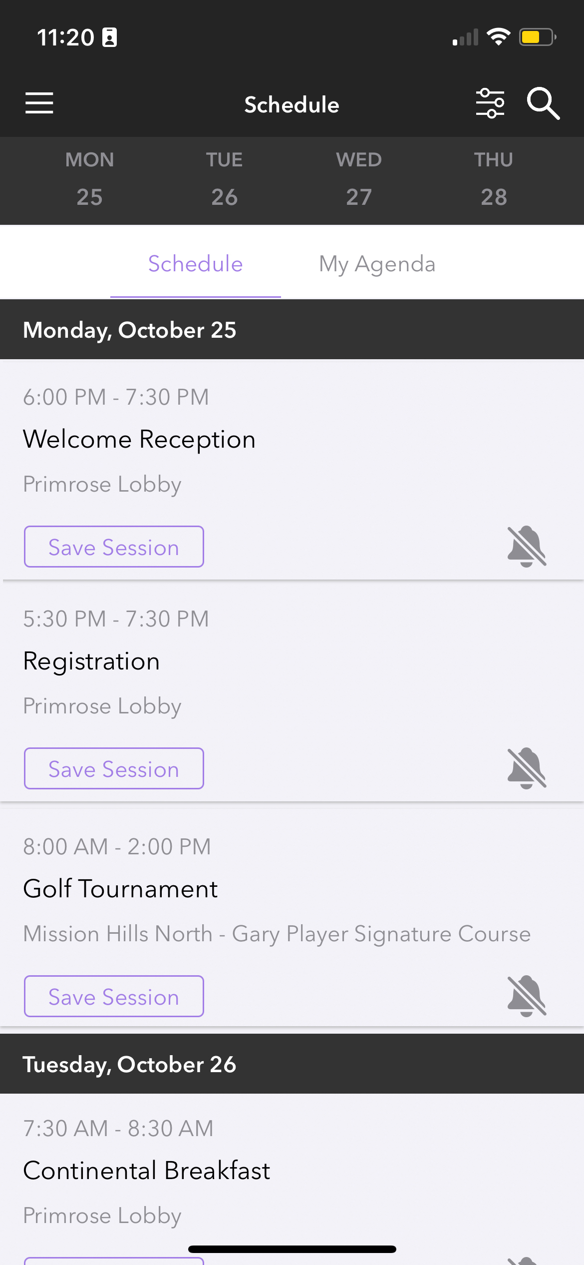
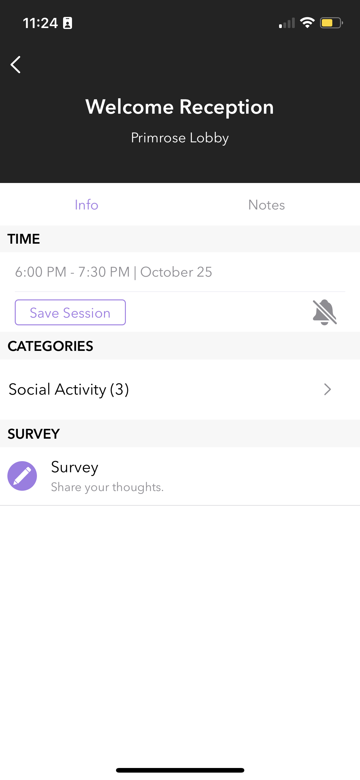
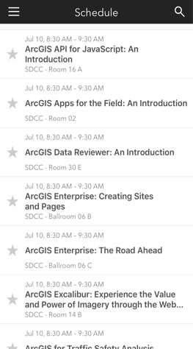
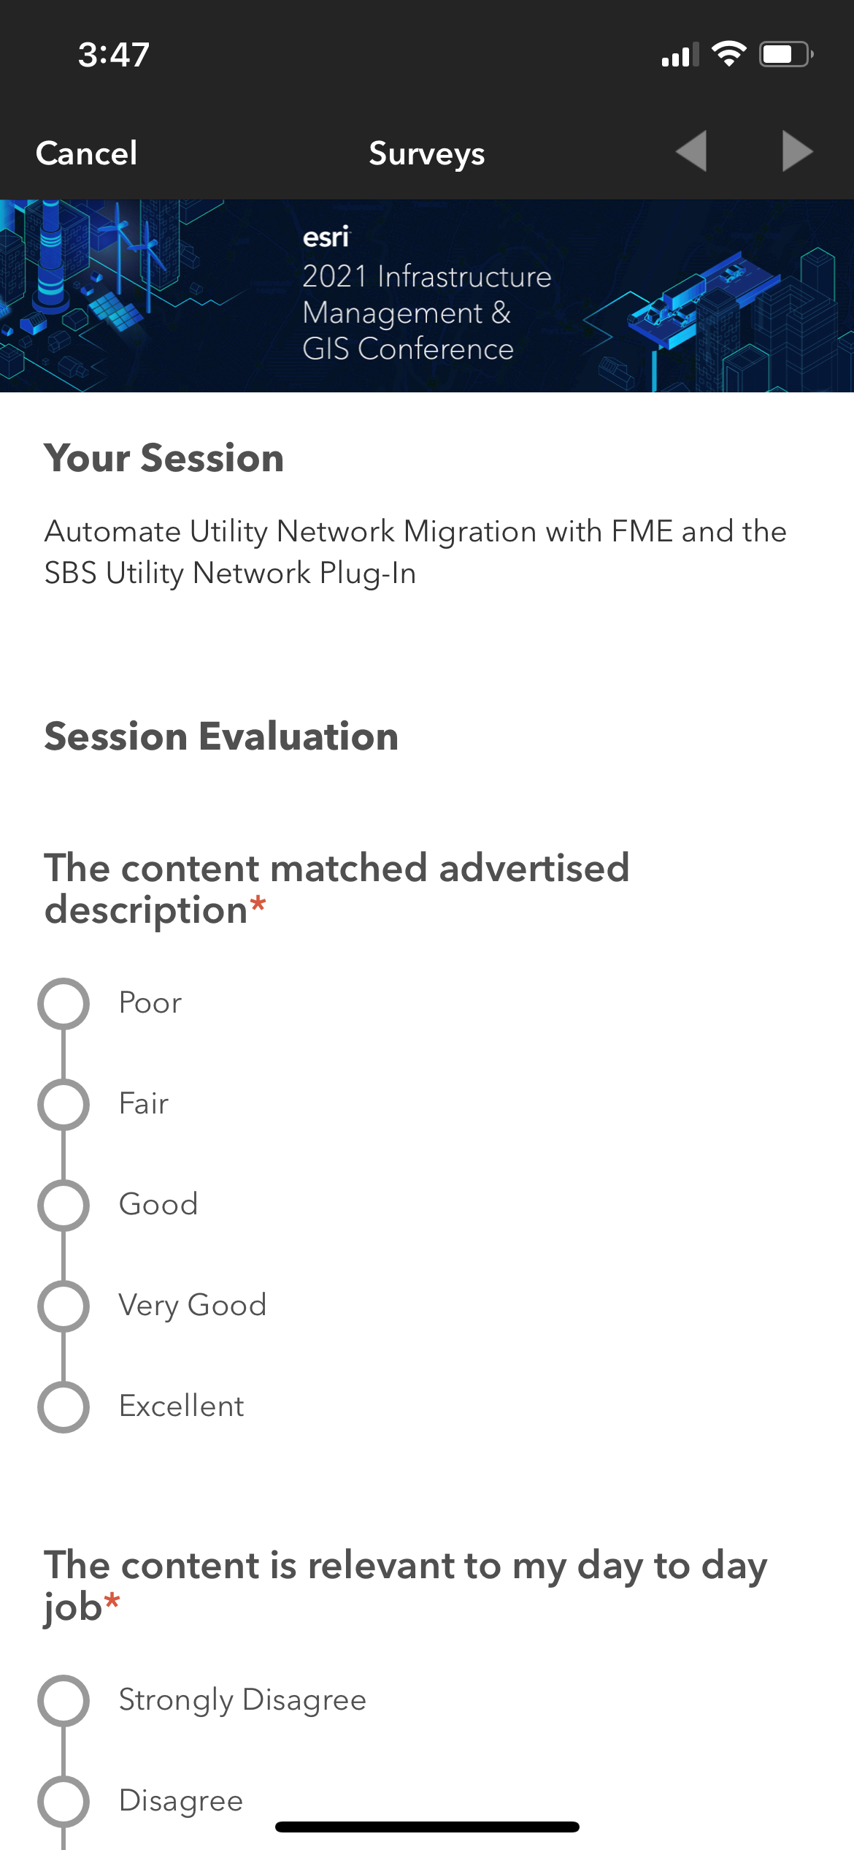
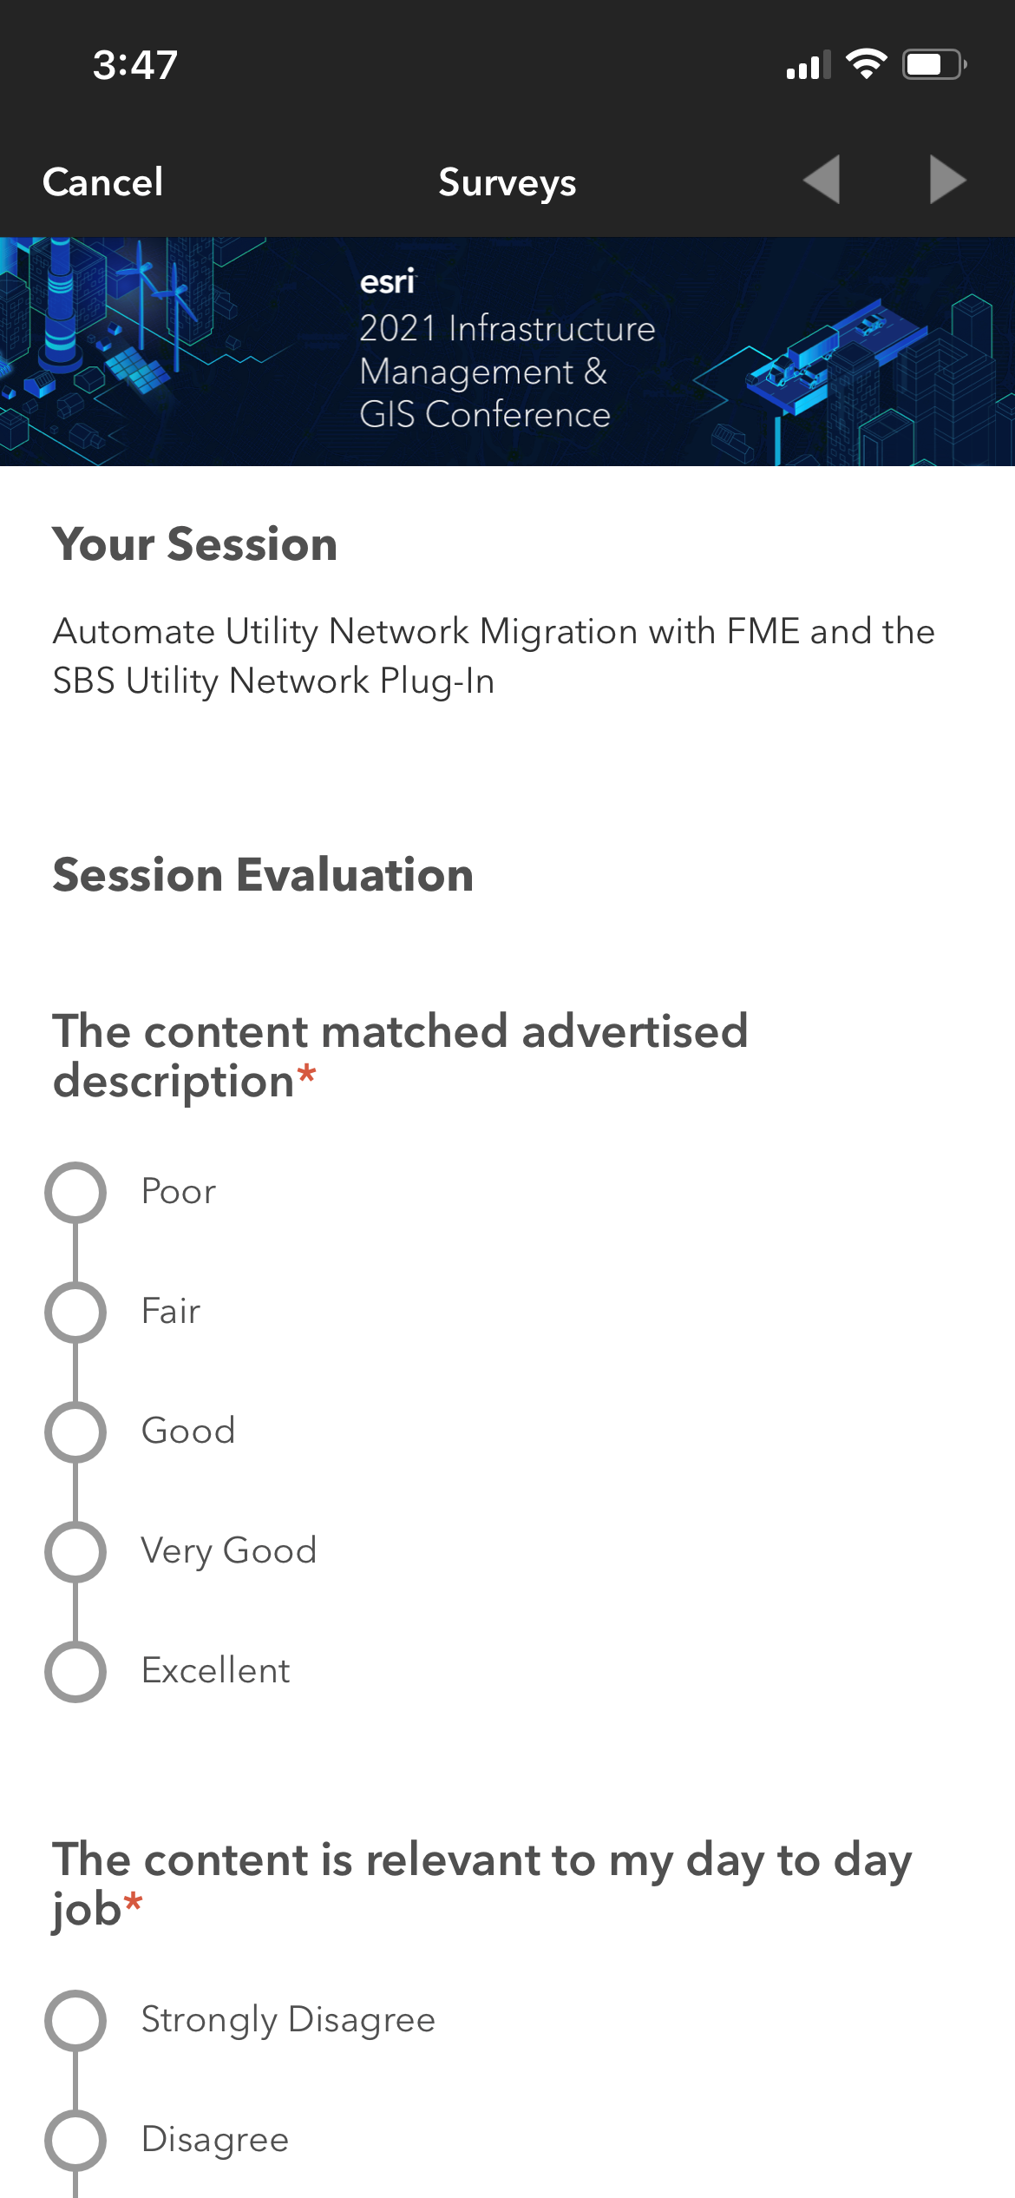
Please Share Your Feedback in the App
Download the Esri Events app and find your event
Select the session you attended
Scroll down to “Survey”
Log in to access the survey

Slide 27



Copyright © 2022 Esri. All rights reserved.

Slide 28
Presentation Title
Presenter Names
2022 ESRI DEVELOPER SUMMIT
Notes:
2022 Esri Developer Summit

Slide 29
Headline
Subhead
Bullets

Slide 30
Headline
Subhead
Bullets

Slide 31
Section Header
Section Subhead

Slide 32

Section Header
Section Subhead

Slide 33
Demo Title
Demo Presenter

Slide 34
Please Share Your Feedback in the App
Download the Esri Events app and find your event
Select the session you attended
Scroll down to “Survey”
Log in to access the survey

Slide 35
Copyright © 2022 Esri. All rights reserved.

